Slide 1
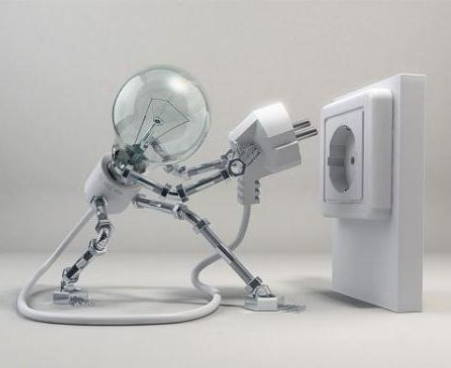
SELF HELP

Slide 2

what is self help ?

Slide 3
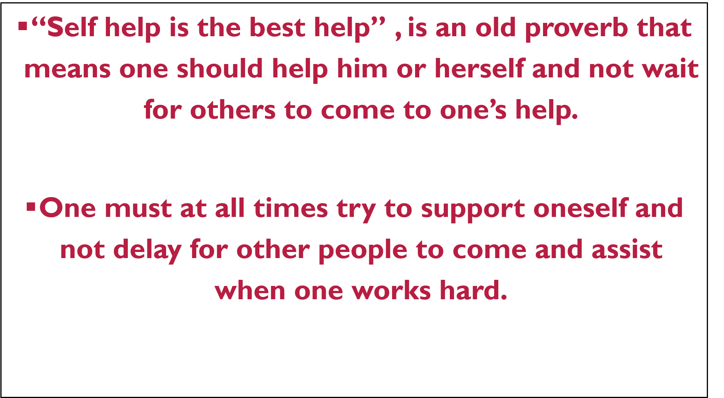

Slide 4
HERE THERE IS SMALL STORY THIS WILL CONCLUDE YOU HOW “SELF HELP IS THE BEST HELP”

Slide 5
Michael was a final year student of Electrical engineering was remarkably brilliant in studies. He was a scholarship undergraduate student because his parents were tailors and could not provide to pay for his studies.
Michael did part time jobs so that he could make and save some cash for his studies and personal needs. His part time job was pizza delivery normally in the evenings. One evening ,he was delivering pizza as usual to occupants of a huge bungalow when there was a power malfunction.
Confusion occurred and Michael provided to check the fuse because he suspected there was a problem. In a few moments , he reported and had the fuse changed and every occupant was happy and thanked him.

Slide 6
They had a conversation with him and were astonished to find he was an engineering student. He also informed them that he will be receiving a reward for his school performance at the ceremony the following day.
The next day at the ceremony like Michael said he was called to the platform to earn his reward. The main guest who was an important industrialist approached the mike and had this to say, “I am encouraged by the drive level of this young man. Despite many challenges , he has had the courage to work to gain excellence. He is a role model of how young men should be .
As a gift of my admiration , I have decided that I will handle all expenses for the higher learning abroad and support him in whatever he desires to pursue in the future.” There was loud applause from the gathering and Michael’s parents were jubilant on hearing the great news of their son.

Slide 7
It was then Michael remembered that he had brought pizzas at the industrialist residence last evening. The industrialist heard Michael’s conversation with his wife and it was good chance that he was the main guest at the ceremony. A good person stepped forward to help Michael since he helped himself in his academics by doing part time job.
In conclusion, self help is the best help and therefore is should be improved by everyone. It will not only make one active and smart but enable many of one’s problems to be solved instantly. Good and great men in history have always advocated self help, since it is the value that makes a person great. Though self help, one can become self made. Parents should teach this to children and must practice it before they teach to children.

Slide 8


Slide 9


Slide 10
THANK YOU..
FROM
UG2
VAKA YAGNA KARTHIK
20170010170

